Slide 1
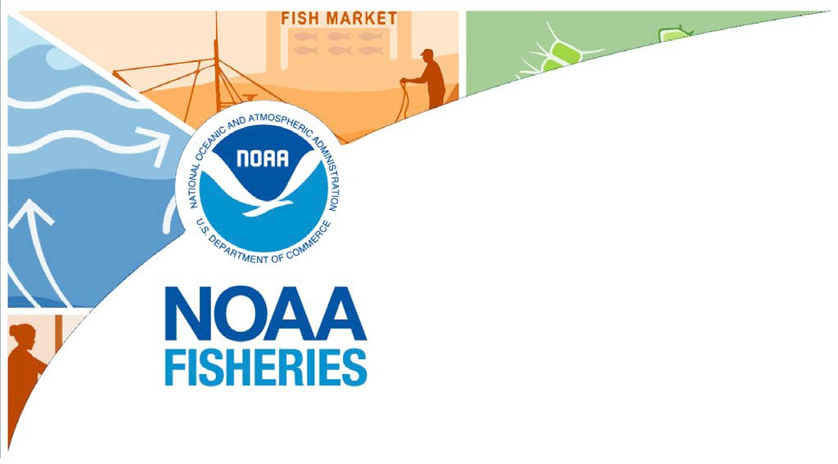
State of the Ecosystem
New England 2025
NEFMC Update 16 April 2025
Joseph Caracappa, (lead editor)

Slide 2
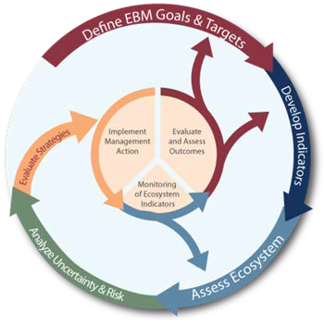
State of the Ecosystem (SOE) reporting
Improving ecosystem information and synthesis for fishery managers
Ecosystem indicators linked to management objectives (DePiper et al., 2017)
Contextual information Report evolving since 2016
Fishery-relevant subset of full Ecosystem Status Reports
Open science emphasis
Used within MAFMC's Ecosystem Process
Risk assessment (Gaichas et al., 2018) Conceptual modeling
Management strategy evaluation (MSE) Used within the NEFMC's Risk Policy
The IEA Loop¹
[1] https://www.integratedecosystemassessment.noaa.gov/national/IEA- approach
2 / 49

Slide 3
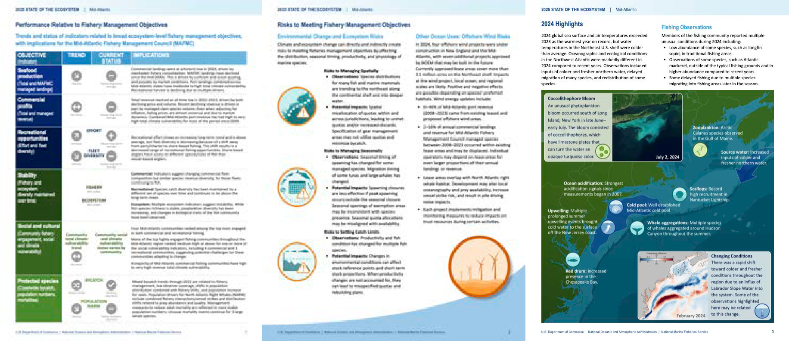
State of the Ecosystem: Maintain 2024 structure for 2025
2025 Report Structure
Graphical summary
Page 1 report card re: objectives →
Page 2 risk summary bullets Page 3 2024 snapshot
Performance relative to management objectives
Risks to meeting management objectives Climate and Ecosystem risks Offshore wind development
2024 Highlights
4 / 49

Slide 4
Updated Objectives and Risks tables aligning with indicators
Ecosystem-scale fishery management objectives in New England Risks to meeting fishery management objectives in New England
Objective categories | Indicators reported
Objectives: Provisioning and Cultural Services
Seafood Production | Landings; commercial total and by feeding guild; recreational harvest
Commercial Profits | Revenue decomposed to price and volume
Recreational Opportunities | Angler trips; recreational fleet diversity
Stability | Diversity indices (fishery and ecosystem)
Social & Cultural | Community fishing engagement and social vulnerability status
Protected Species | Bycatch; population (adult and juvenile) numbers; mortalities
Potential Drivers: Supporting and Regulating Services
Management | Stock status; catch compared with catch limits
Biomass | Biomass or abundance by feeding guild from surveys
Environment | Climate and ecosystem risk indicators listed in Table 2
Risk categories | Observation indicators reported | Potential driver indicators reported
Climate and Ecosystem Risks
Risks to Managing Spatially | Managed species (fish and cetacean) distribution shifts | Benthic and pelagic forage distribution; ocean temperature, changes in currents and cold pool
Risks to Managing Seasonally | Managed species spawning and migration timing changes | Habitat timing: Length of ocean summer, cold pool seasonal persistence
Risks to Setting Catch Limits | Managed species body condition and recruitment changes | Benthic and pelagic forage quality & abundance: ocean temperature & acidification
Other Ocean Uses Risks
Offshore Wind Risks | Fishery revenue and landings from wind lease areas by species and port | Wind development speed; Protected species presence and hotspots
TOR:C1 - These objectives are partially derived from MSA & National Standard. We'd like to move towards more "true objectives" with desired outcomes and/or reference points.
4 / 49

Slide 5
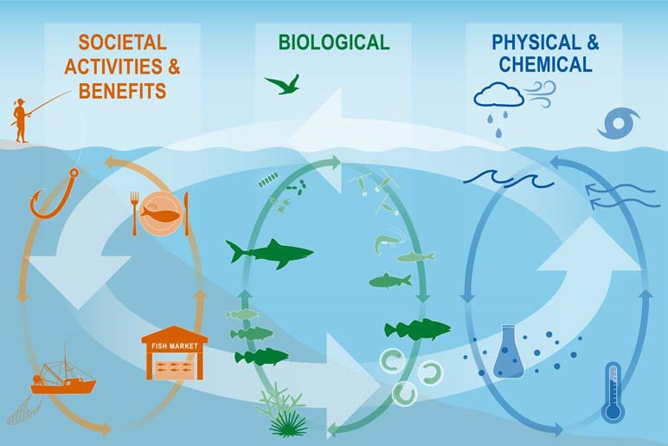
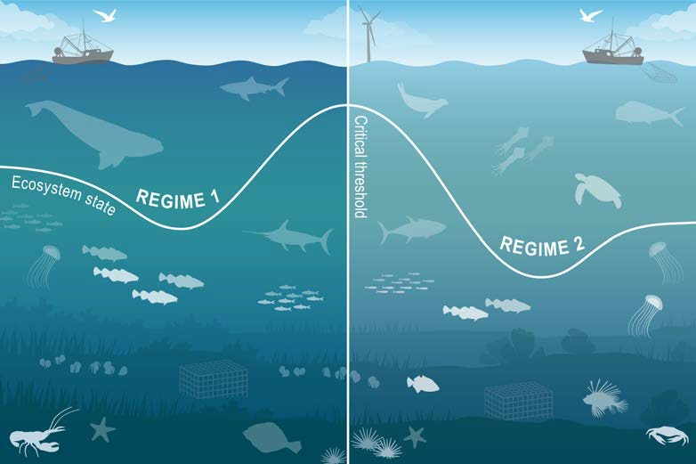
Ecosystem synthesis themes
Characterizing ecosystem change for fishery management
Societal, biological, physical and chemical factors comprise the multiple system drivers that influence marine ecosystems through a variety of different pathways.
Changes in the multiple drivers can lead to regime shifts — large, abrupt and persistent changes in the structure and function of an ecosystem.
Regime shifts and changes in how the multiple system drivers interact can result in ecosystem reorganization as species and humans respond and adapt to the new environment.
.
4 / 49

Slide 6
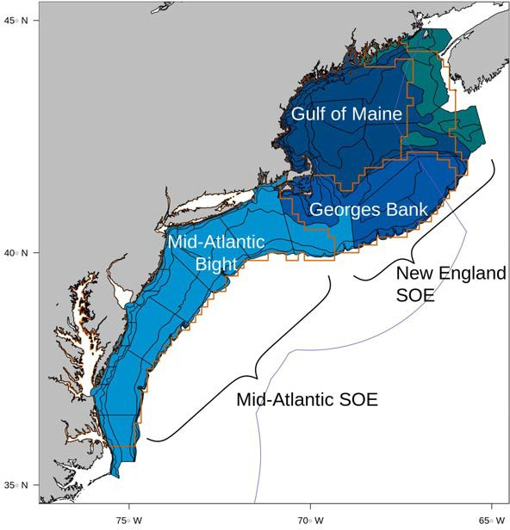
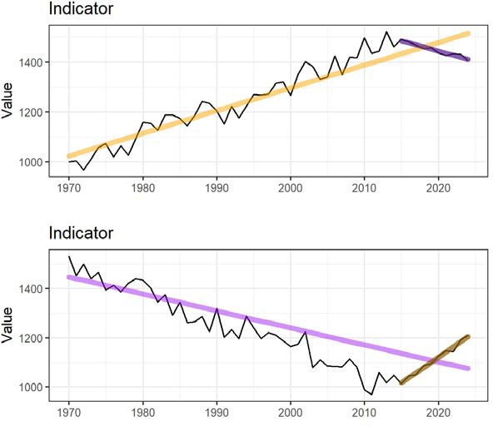
State of the Ecosystem report scale and figures
Spatial scale
Key to figures
Long-term trends assessed only for 30+ years: more information Short-term trends assessed for last 10 years of data OR a full time series <30 years
Orange line = significant increase Purple line = significant decrease
No color line = not significant or < 30 years
A glossary of terms, detailed technical methods documentation, and indicator data and catalog are available online.
Grey background = last 10 years
6 / 49

Slide 7
Report structure 2024: same as 2021-2023 with more management risk emphasis
Performance relative to management objectives What does the indicator say--up, down, stable?
Why do we think it is changing: integrates synthesis themes
Multiple drivers
Regime shifts
Ecosystem reorganization Objectives
Seafood production Profits
Recreational opportunities Stability
Social and cultural Protected species
Risks to meeting fishery management objectives Same What and Why as Performance Section
New structure for Climate section Fishery risk indicator
Climate and ecosystem drivers of fishery risk
Future considerations Risk categories
Climate and Ecosystem Change Risk to spatial management Risk to seasonal management Risk to quota setting/rebuilding
Other ocean uses
Offshore wind development
7 / 49

Slide 8
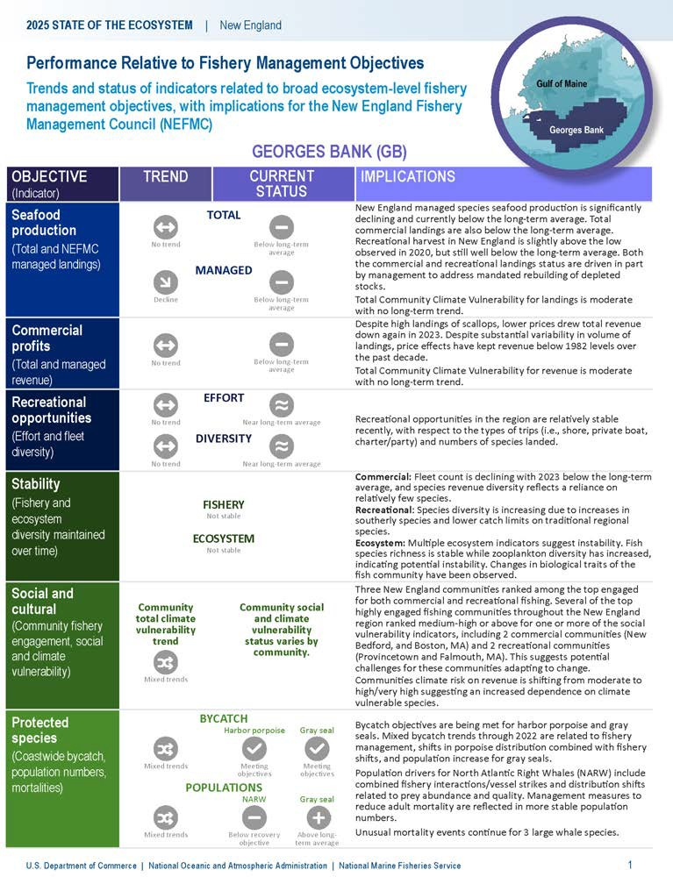







New England State of the Ecosystem Summary 2025:
Performance relative to management objectives - Georges Bank
Seafood production Total , Managed , Both Profits ,
Recreational opportunities: Effort , ; Effort diversity , Stability: Fishery not stable; Ecological not stable
Social and cultural:
Fishing engagement and social vulnerability status by community
Revenue climate vulnerability , majority medium risk
Protected species:
Maintain bycatch below thresholds (harbor porpoise, gray seals)
Recover endangered populations , NARW Gray seal
7 / 49

Slide 9
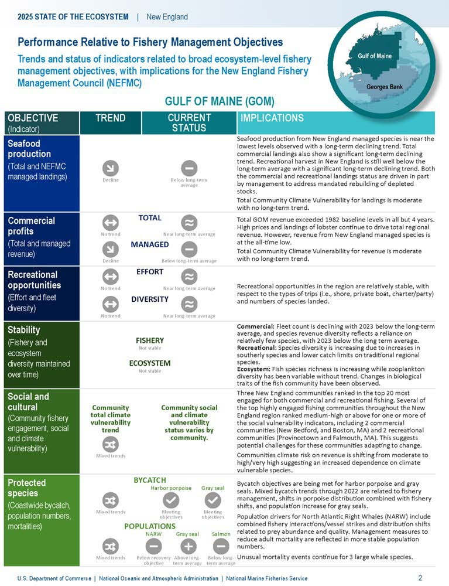
New England State of the Ecosystem Summary 2025:
Performance relative to management objectives - Gulf of Maine
Seafood production ,
Profits Total , ; NEFMC Managed ,
Recreational opportunities: Effort , ; Effort diversity , Stability: Fishery not stable; Ecological not stable
Social and cultural:
Fishing engagement and social vulnerability status by community
Revenue climate vulnerability , majority medium risk
Protected species:
Maintain bycatch below thresholds (harbor porpoise, gray seals)
Recover endangered populations , NARW Gray seal Salmon
9 / 49

Slide 10
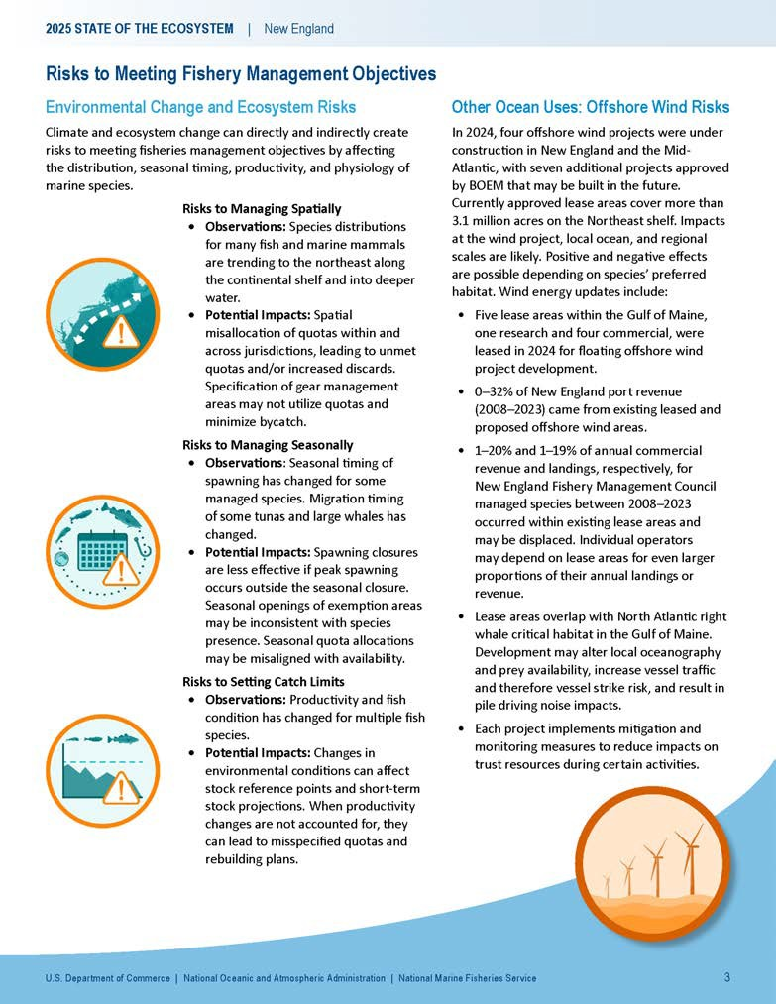
State of the Ecosystem Summary 2025:
Risks to meeting fishery management objectives
Climate: risks to managing spatially, managing seasonally, and catch specification
Fish and protected species distribution shifts Changing spawning and migration timing
Multiple stocks with poor condition, declining productivity
Other ocean uses: offshore wind development
Current revenue in proposed areas 1-46% by Mid-Atlantic port
2-16% by MAFMC managed species
Overlap with important right whale foraging habitats, increased vessel strike and noise risks

Slide 11
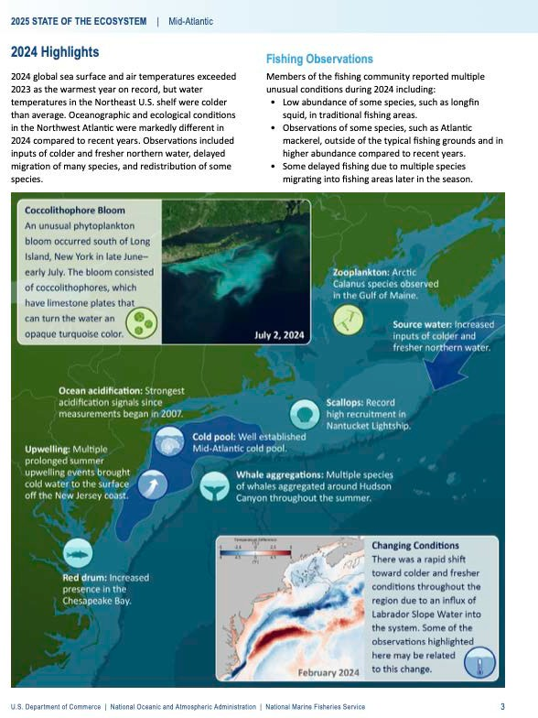
State of the Ecosystem Summary 2025: 2024 Highlights
Notable 2024 events and conditions
2024 warmest year on record globally. Again.
BUT
Cooler conditions across the coast Well established Mid Atlantic Cold Pool
Multiple summer upwelling events off NJ Extreme ocean acidification measured off NJ
Many fishery observations of different spatial and timing patterns, changed abundance
Good scallop recruitment in Nantucket lightship More red drum in Chesapeake Bay
Arctic copepods in GOM Cocolithophore bloom off NY Large whale aggregations
We welcome your observations! northeast.ecosystem.highlights@noaa.gov

Slide 12
SSC and Council Requests from 2024 and Prioritization

Slide 13
2025 State of the Ecosystem Request tracking memo
Request | Year | Rank | Source | Status | Progress
System level thresholds/ref pts
Compare EOF (Link) thresholds to empirical thresholds (Large, Tam) | 2021 | Highest | MAFMC SSC | In progress | Analysis planning with Mid SSC
Simulation analysis to gauge effectiveness of indicators (e.g. EOF testing) | 2024 | Highest | MAFMC SSC | In progress for EOF | Analysis planning with Mid SSC
Trend Analysis / Inflection / Break points / Early warning variance | 2019 - 2024 | Highest | Both Councils and SSCs | In SOE (trends) | New short term trend analysis included
Optimum yield for ecosystem | 2021 | Highest | NEFMC | In progress | Analysis planning with Mid SSC
Include standardized language about uncertainty from e.g. IPCC or NCA applicable to each indicator or data input | 2024 | Highest | NEFMC SSC | Not started | Lacking resources this year
Establish more links between events and consequences (e.g. temp ranges for more species) | 2024 | Highest | MAFMC SSC | In progress | Temperature threshold analysis in progress
How does phyto size comp affect EOF indicator, if at all? | 2021 | High | MAFMC | In progress | Analysis planning with Mid SSC
Sum of TAC/ Landings relative to TAC | 2021, 2023 | Moderate | MAFMC SSC | In SOE-MAFMC, In progress- NEFMC | Seafood Production section
Nutrient input, Benthic Flux and POC (particulate organic carbon) to inform benthic productivity by something other than surface indicators | 2021, 2023 | Low | MAFMC SSC | In SOE | Benthos abuncance and distribution indices included
Reduce indicator dimensionality with multivariate statistics | 2020 | Lowest | NEFMC | In progress | Analysis planning with Mid SSC
Management

Slide 14
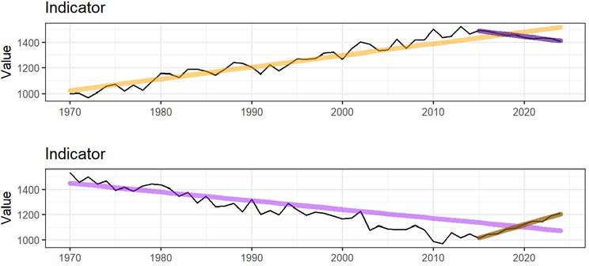
2025 Changes: Trend assessment
Recent short term trends assessed
Andy Beet's arfit RR ppaacckkaaggee integrated into ecodata Apply to most recent 10 years of each dataset Apply to full datasets <30 years
No more polynomial long term trends assessed
Decision based on how strange some of them looked
Has implications for risk assessment scoring

Slide 15
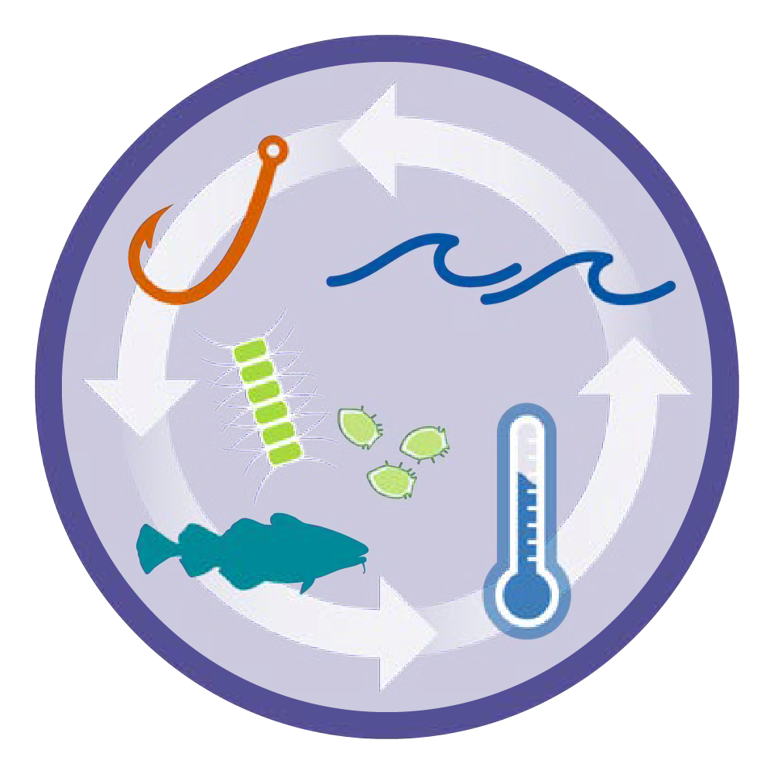
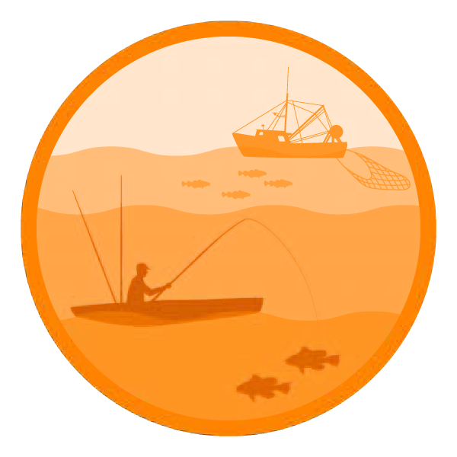
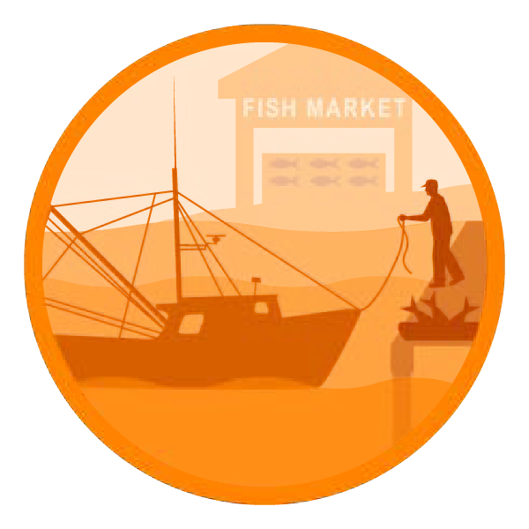


2025 Performance relative to management objectives

Slide 16



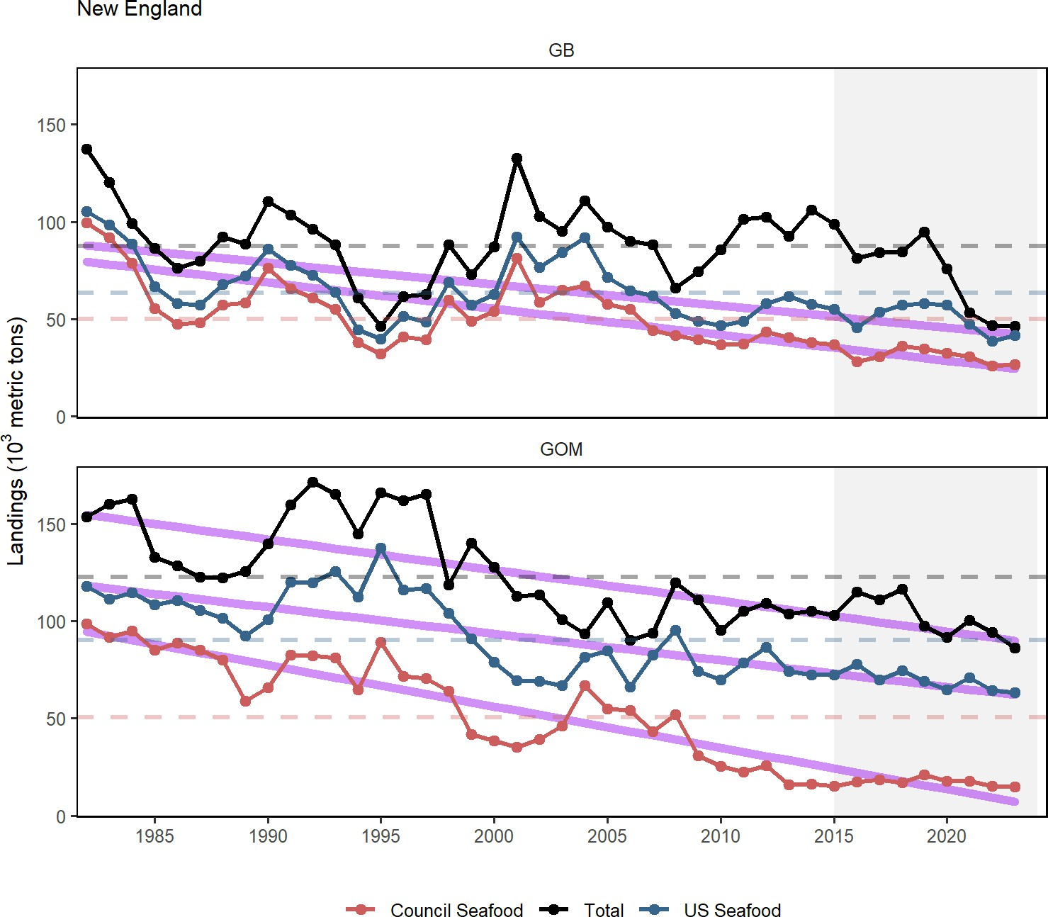
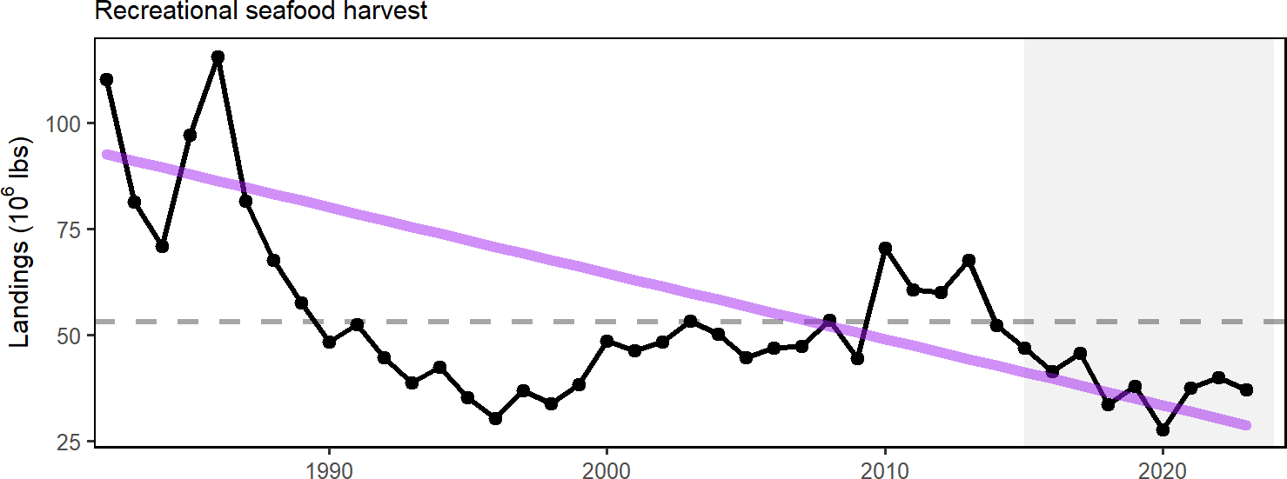
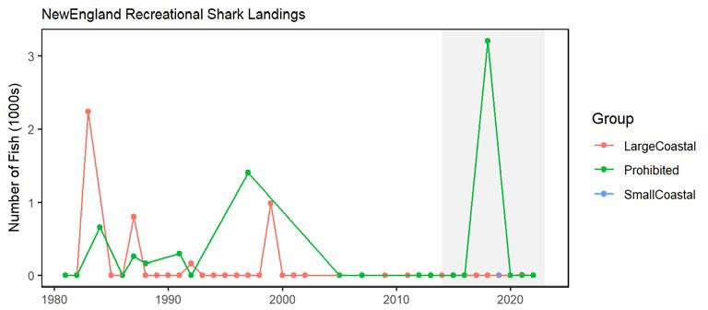
Objective: New England Seafood production /
Indicators: Commercial landings
Indicators: Recreational harvest
Multiple drivers: ecosystem and stock production, management actions (stock rebuilding), market conditions (including COVID-19 disruptions), and environmental change
16 / 49

Slide 17
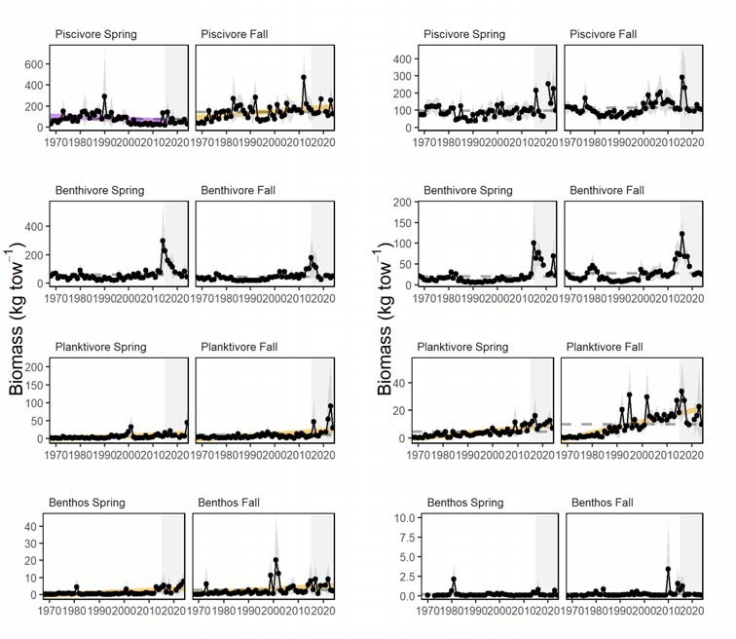
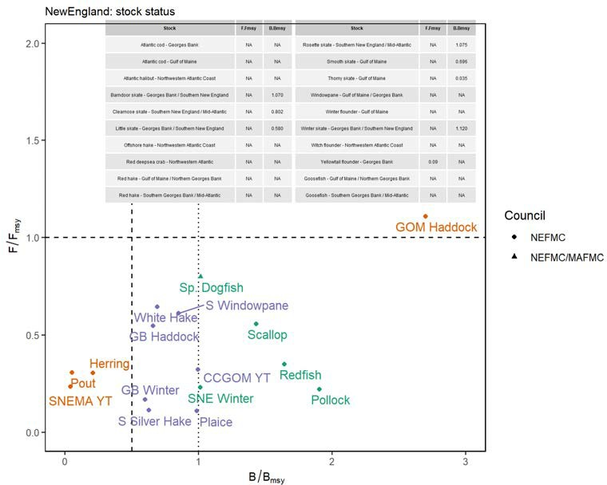
New England Landings drivers: Stock status? Survey biomass?
Indicator: Stock status
Indicator: Survey biomass
One more stock below BMSY from last year (S Silver Hake). No change in stocsk below 1/2 BMSY. Stock status and required management actions still likely playing large role in seafood declines.
Biomass availability still seems unlikely driver

Slide 18
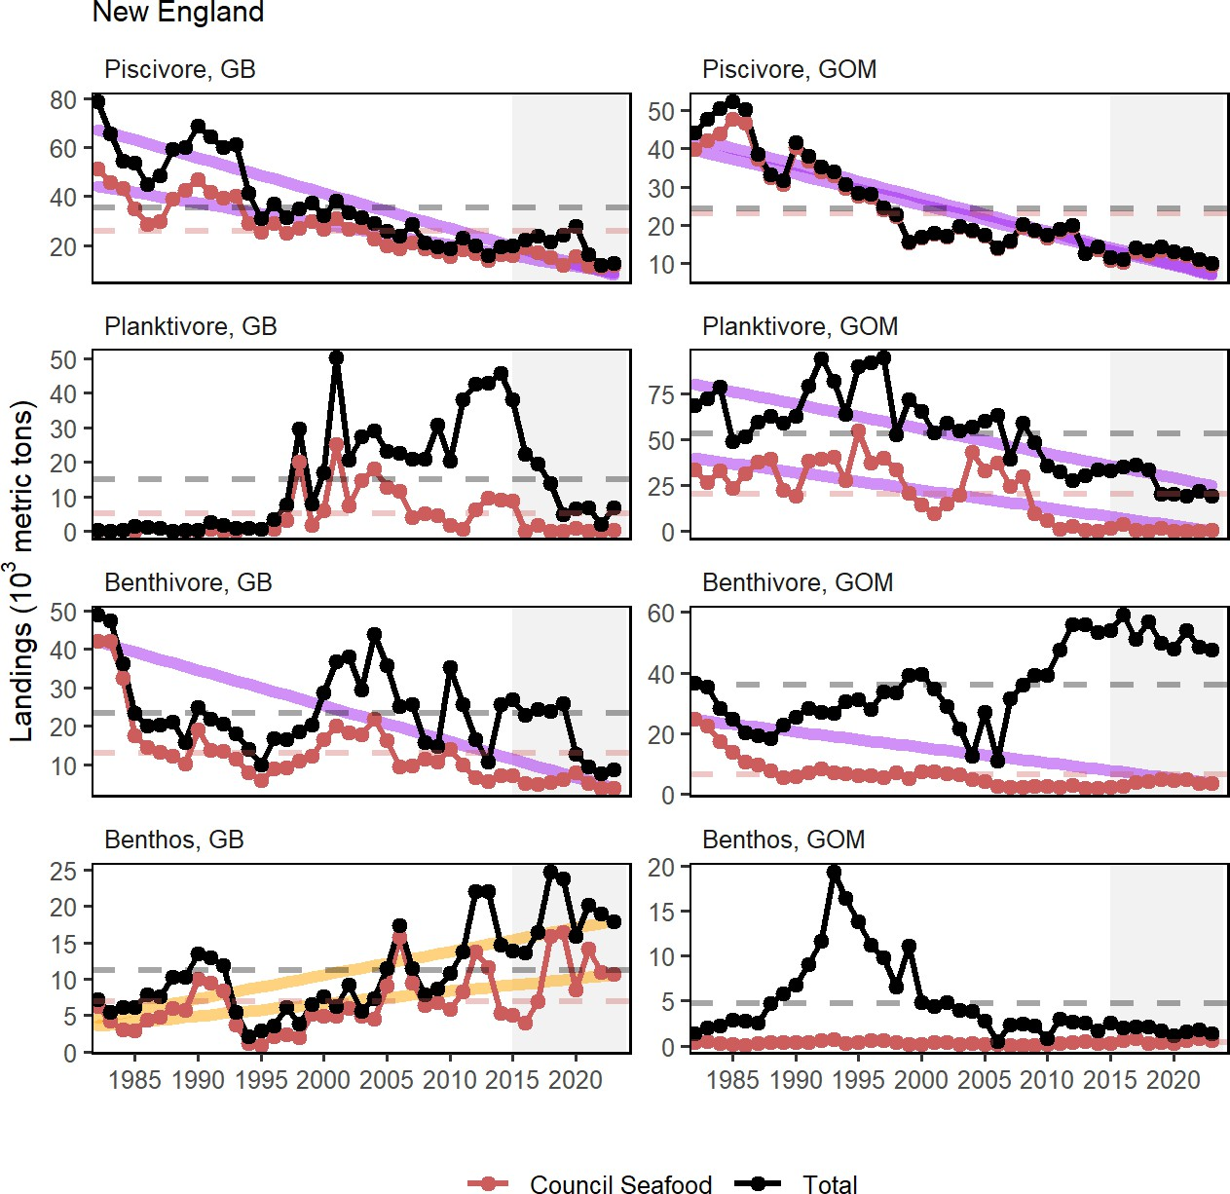
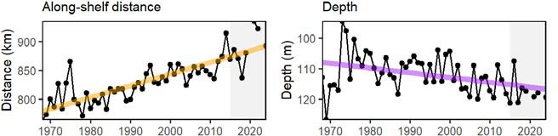
Implications: New England Seafood Production
Drivers:
Decline in commercial landings is most likely driven by actions to rebuild individual stocks (lower quotas) as well as market dynamics other drivers affecting recreational landings: tighter shark fishery regulations, changing demographics and preferences of anglers
Monitor:
Climate risks including warming, ocean acidification, and shifting distributions Ecosystem composition and production changes Fishing engagement

Slide 19

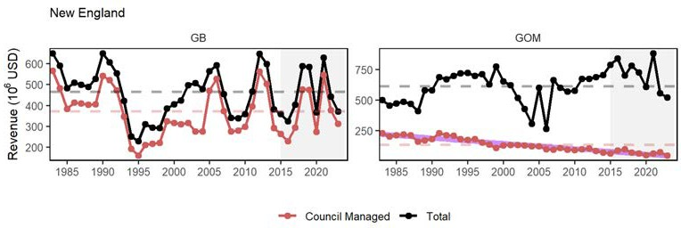
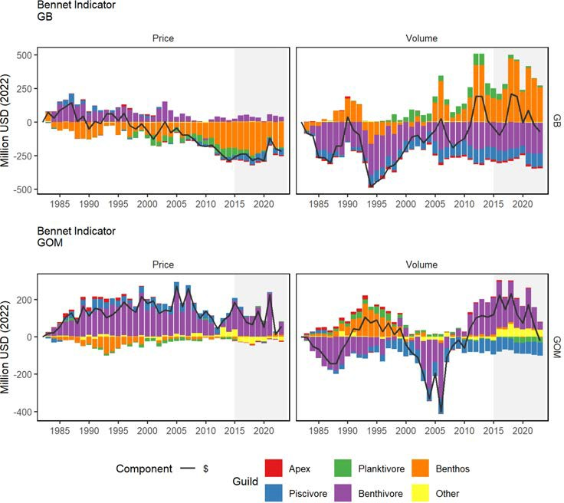
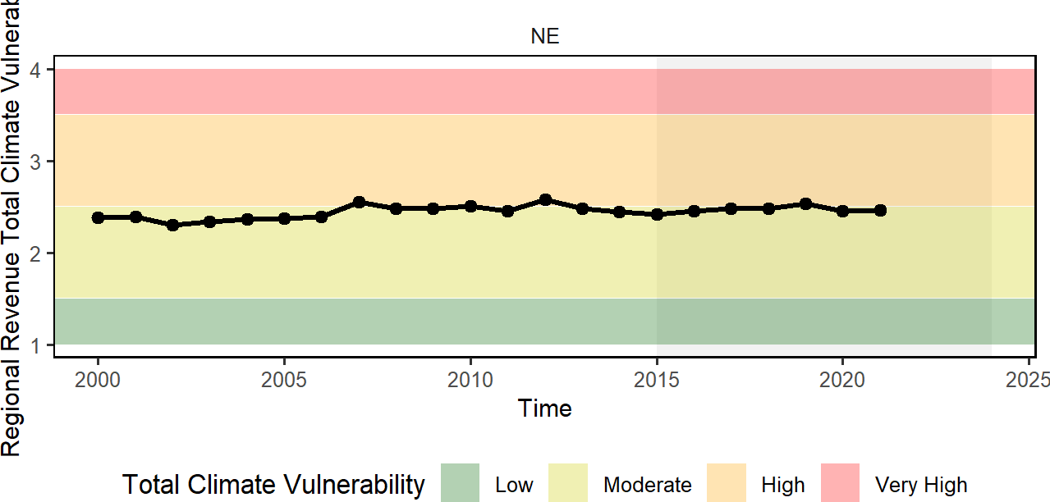
Objective: New England Commercial Profits
Indicator: Commercial Revenue; profit indicators are under SSC review
Indicator: Bennet--price and volume indices
Both regions dependent on single climate-vulnerable species
GOM high revenue despite low volume
19 / 49

Slide 20

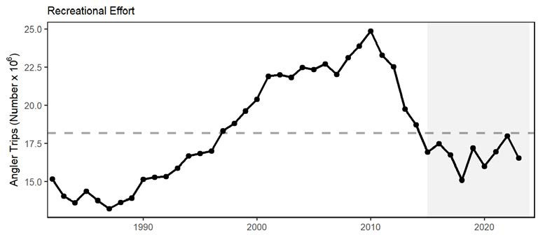
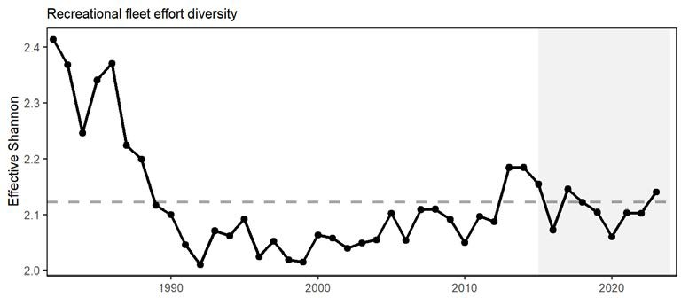
Objective: New England Recreational opportunities
Indicators: Recreational effort and fleet diversity
Implications
Absence of a long-term trend in recreational effort suggests relative stability in the overall number of recreational opportunities in New England
20 / 49

Slide 21
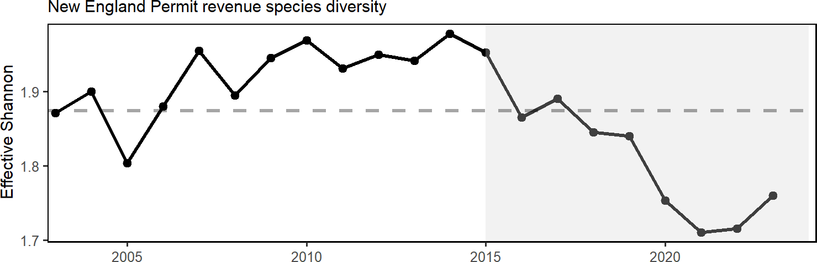
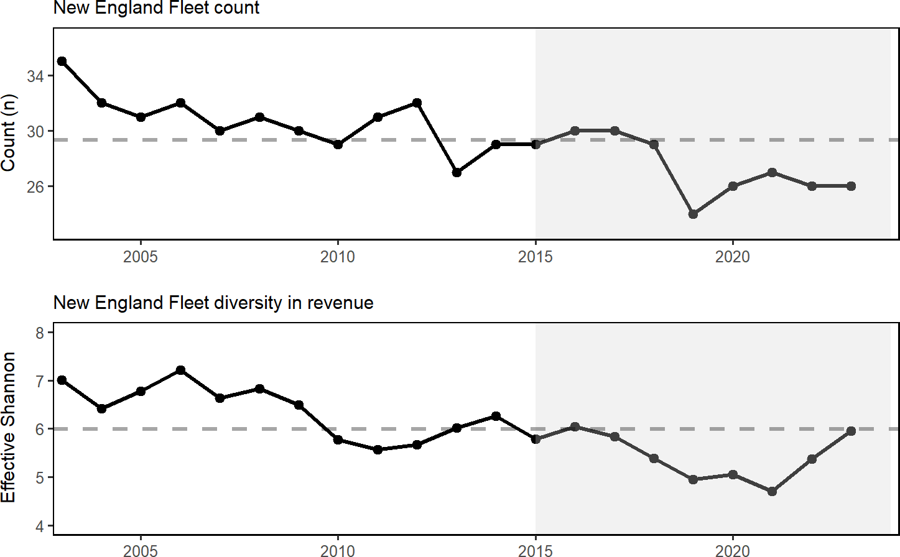
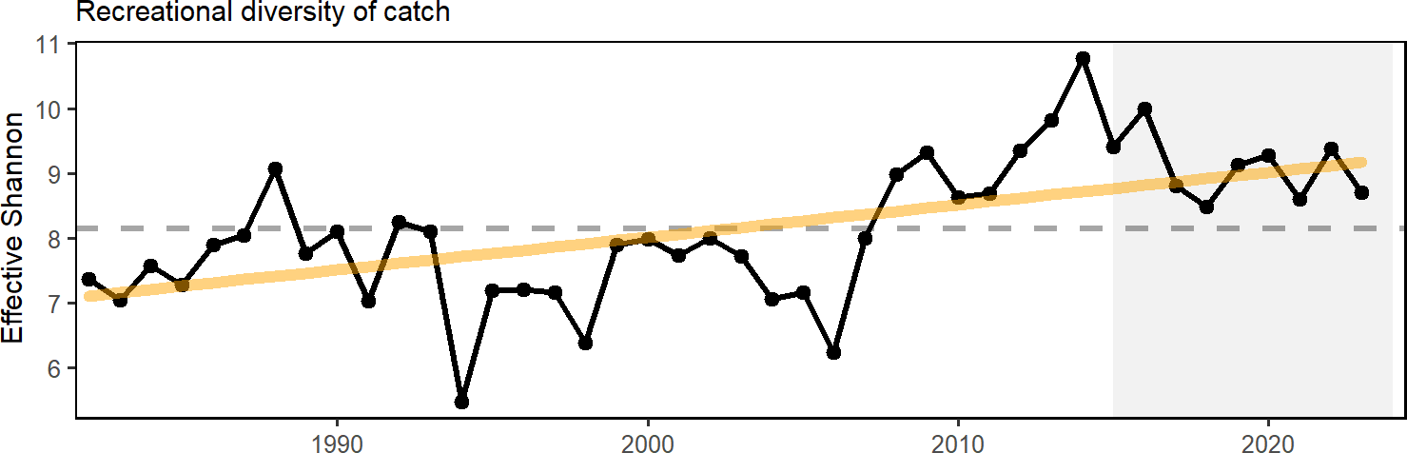
Objective: New England Fishery Stability: Not Stable
Fishery Indicators: Commercial fleet count, fleet diversity
Fishery Indicators: commercial species revenue diversity, recreational species catch diversity
Fishery Implications:
Commercial fishery diversity driven by small number of species -> less capacity to respond to new opportunities
Recreational diversity increase due to increase in ASFMC and MAFMC managed species
21 / 49

Slide 22

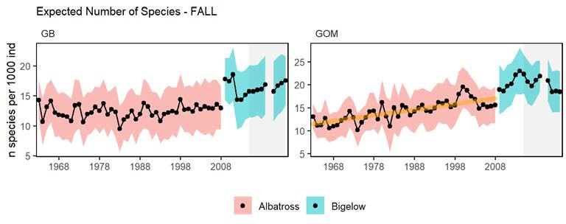
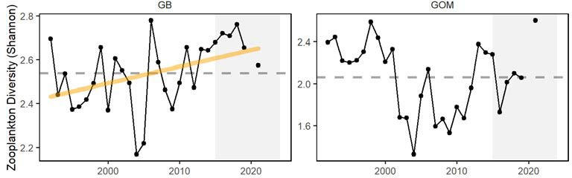
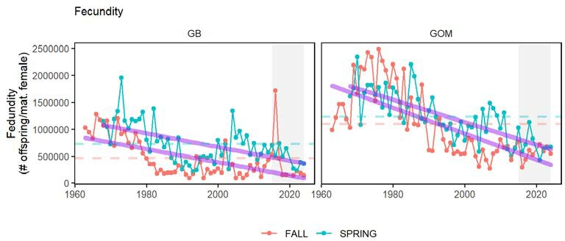
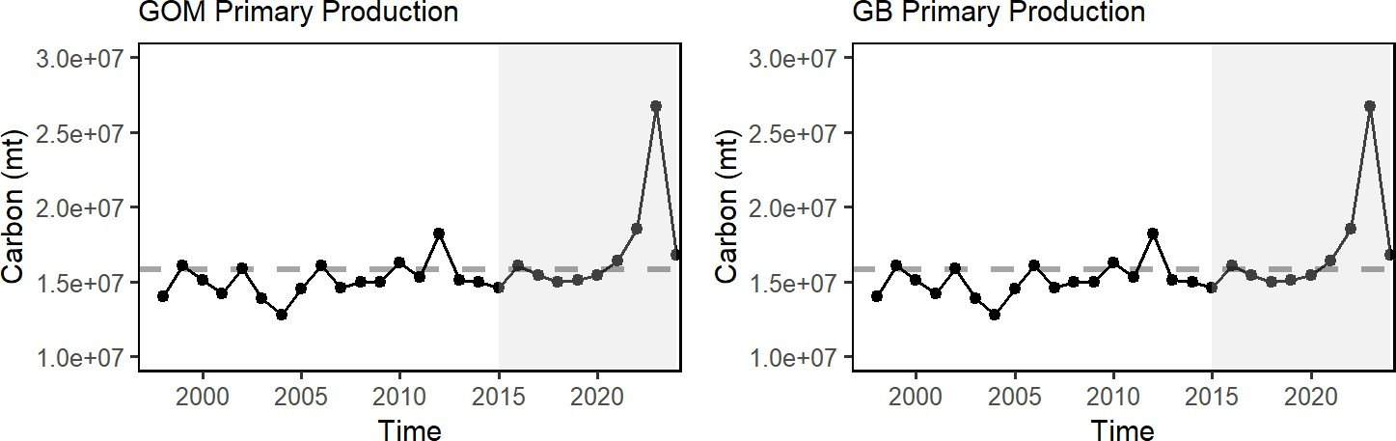
Objective: New England Ecological Stability
Ecological Indicators: zooplankton diversity (not updated) and total primary production
Ecological Indicators: fish richness and traits
Ecological Implications:
Adult diversity in GOM suggests increase in warm-water species
Declines in species fecundity & other life history traits suggests changing ecology
22 / 49

Slide 23
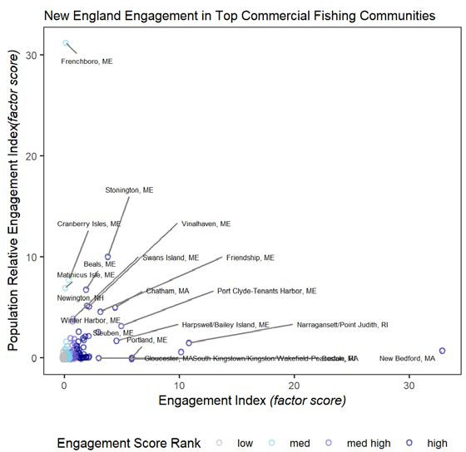
New England Community Social and Climate Vulnerability
Indicators: Commercial fishery engagement, social vulnerability, revenue climate vulnerability
Time | EPU | Town | Eng | Eng_ct | Rel | Rel_ct | Personal Disruption | Population Composition | Poverty
2022 | NE | New Bedford, MA | 32.873 | 4 | 0.702 | 3 | 3 | 4 | 3
2022 | NE | Narragansett/Point Judith, RI | 10.842 | 4 | 1.476 | 4 | 1 | 1 | 1
2022 | NE | Gloucester, MA | 10.126 | 4 | 0.570 | 3 | 1 | 1 | 1
2022 | NE | Portland, ME | 5.870 | 4 | 0.010 | 2 | 1 | 1 | 1
2022 | NE | Boston, MA | 5.860 | 4 | -0.109 | 1 | 2 | 4 | 3
2022 | NE | Port Clyde- Tenants Harbor, ME | 4.940 | 4 | 3.147 | 4 | 2 | 1 | 2
2022 | NE | Harpswell/Bailey Island, ME | 4.533 | 4 | 1.660 | 4 | 1 | 1 | 1
2022 | NE | Chatham, MA | 4.404 | 4 | 5.002 | 4 | 1 | 1 | 1
2022 | NE | Stonington, ME | 3.773 | 4 | 10.002 | 4 | 1 | 1 | 1
2022 | NE | Friendship, ME | 3.107 | 4 | 4.573 | 4 | 1 | 1 | 1
Implications: Highlighted communities may be vulnerable to changes in fishing patterns due to regulations and/or climate change. When also experiencing social vulnerabilities, they may have lower ability to successfully respond to change.
23 / 49

Slide 24
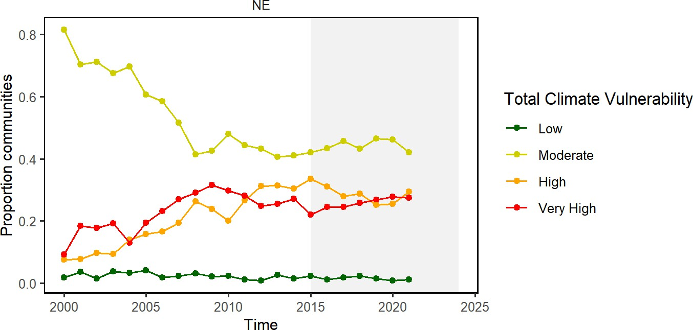
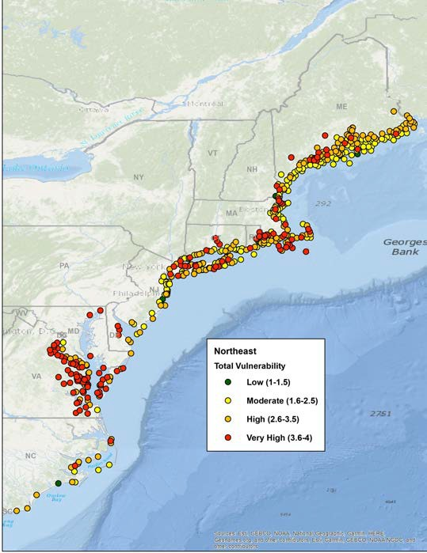
New England Social and Climate Vulnerability
Indicators: Commercial fishery revenue climate vulnerability
The Community Climate Change Risk Indicators are calculated by multiplying the percent contribution of species to the total value landed in a community by their respective Total Vulnerability scores (based on NOAA’s Climate Vulnerability Assessment) for different sensitivity and exposure factors and then summing the resulting values by year.
New England communities shifting towads High/Very High climate vulnerability. Consolidating Species
24 / 49

Slide 25
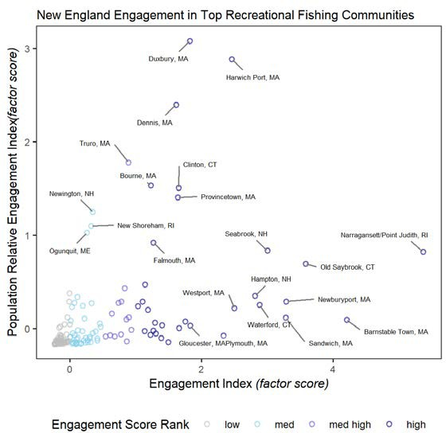
New England Community Social and Climate Vulnerability
Risk element:
Social
Indicators: Recreational fishery engagement, social vulnerability
Time EPU Town
Eng Eng_ct Rel Rel_ct
Personal Disruption
Population Composition
Poverty
2022 NE
Narragansett/Point Judith, RI
5.365
4 0.822
3
1
1
1
Barnstable Town,
2022 | NE | 4.204 |  | 4 | 0.094 | 2 | 1 | 2 | 1
 |  | MA
2022 | NE | Old Saybrook, CT | 3.581 | 4 | 0.696 | 3 | 1 | 1 | 1
2022 | NE | Newburyport, MA | 3.284 | 4 | 0.292 | 2 | 1 | 1 | 1
2022 | NE | Sandwich, MA | 3.280 | 4 | 0.116 | 2 | 1 | 1 | 1
2022 | NE | Seabrook, NH | 3.000 | 4 | 0.835 | 3 | 2 | 1 | 1
2022 | NE | Waterford, CT | 2.884 | 4 | 0.253 | 2 | 1 | 1 | 1
2022 | NE | Hampton, NH | 2.815 | 4 | 0.350 | 2 | 1 | 1 | 1
2022 | NE | Westport, MA | 2.499 | 4 | 0.221 | 2 | 1 | 1 | 1
2022 | NE | Harwich Port, MA | 2.460 | 4 | 2.883 | 4 | 1 | 1 | 1

Slide 26
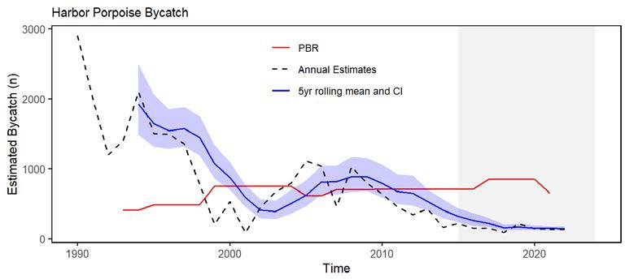
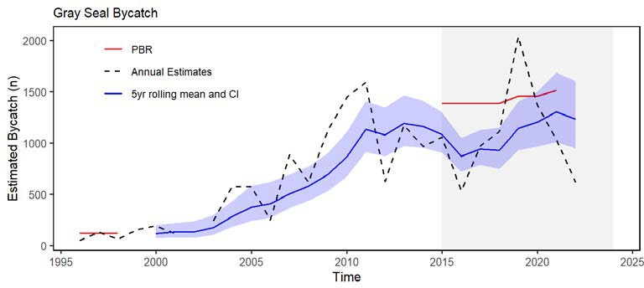
Objectives: Coastwide Protected species Maintain bycatch below thresholds
Indicators: Harbor porpoise and gray seal bycatch
Implications:
Currently meeting objectives, but uncertainty in gray seal estimates
Risk element: TechInteract, evaluated by species
and sector: 14 low, 7 low-mod, 2
mod-high
risk
The downward trend in harbor porpoise bycatch can also be due to a decrease in harbor porpoise abundance in US waters, reducing their overlap with fisheries, and a decrease in gillnet effort.
Gray seal among the highest bycatch of any U.S. marine mammal. The increasing trend in gray seal bycatch may be related to an increase in the gray seal population (U.S. pup counts).

Slide 27
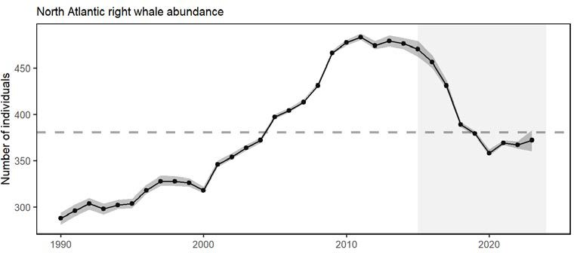
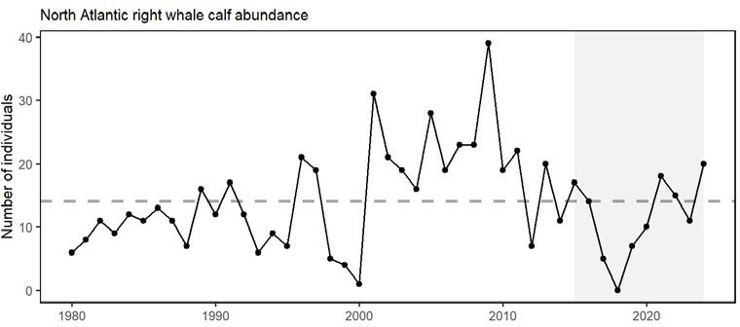
Objectives: Coastwide Protected species Recover endangered populations
Indicators: North Atlantic right whale population, calf counts
Implications:
Signs the adult population stabilized 2020-2023
Population drivers for North Atlantic Right Whales (NARW) include combined fishery interactions/ship strikes, distribution shifts, and copepod availability.
Additional potential stressors include offshore wind development, which overlaps with important habitat areas used year-round by right whales, including mother and calf migration corridors and foraging habitat.
Unusual mortality events continue for 3 large whale species.

Slide 28
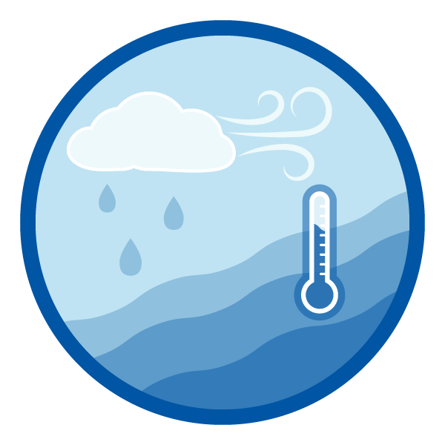

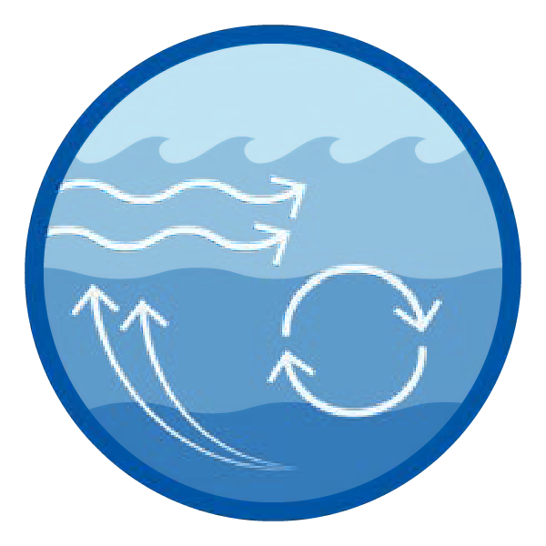
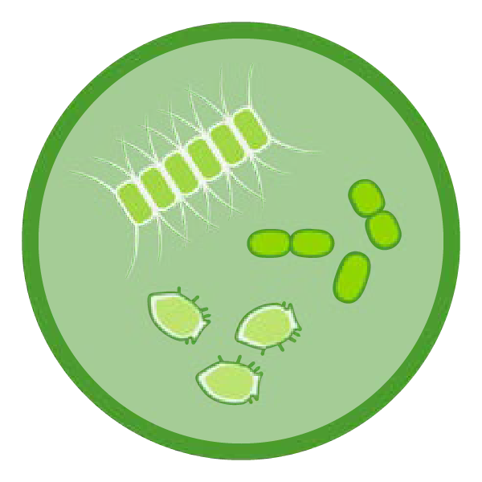


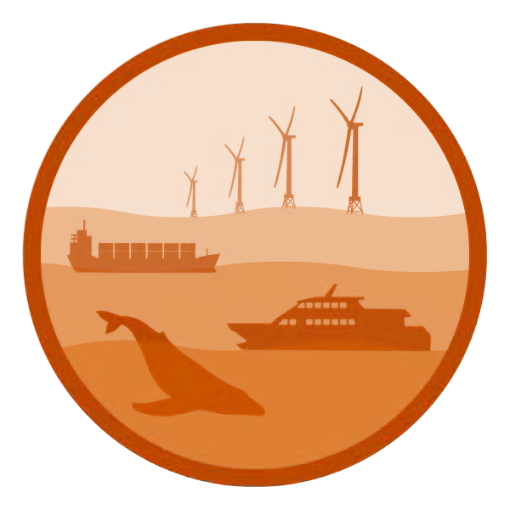
2025 Risks to meeting fishery management objectives

Slide 29
Revised Risks: Climate and Ecosystem Change
Risks to meeting fishery management objectives in New England
Risks to Managing Spatially
Risk categories
Observation indicators reported
Potential driver indicators reported
Potential Impacts: Spatial misallocation of quotas within and across jurisdictions, leading to unmet quotas and/or increased discards. Specification of gear management areas may not utilize quotas and minimize bycatch.
Climate and Ecosystem Risks
Risks to Managing Spatially
Managed species (fish and cetacean) distribution shifts
Benthic and pelagic forage distribution; ocean temperature, changes in currents and cold pool
Risks to Managing Seasonally
Risks to Setting Catch Limits
Managed species spawning and migration timing changes
Habitat timing: Length of ocean summer, cold pool seasonal persistence
Risks to Managing Seasonally
Potential Impacts: Spawning closures are less effective if peak spawning occurs outside the seasonal closure. Seasonal openings of exemption areas may be inconsistent with species presence.
Seasonal quota allocations may be misaligned with availability.
Managed species body condition and recruitment changes
Benthic and pelagic forage quality & abundance: ocean temperature & acidification
Other Ocean Uses Risks
Fishery revenue and landings from wind lease areas by species and port
Wind development speed; Protected species presence and hotspots
Offshore Wind Risks
Risks to Setting Catch Limits
Potential Impacts: Changes in environmental conditions can affect stock reference points and short-term stock projections. When productivity changes are not accounted for, they can lead to misspecified quotas and rebuilding plans.

Slide 30
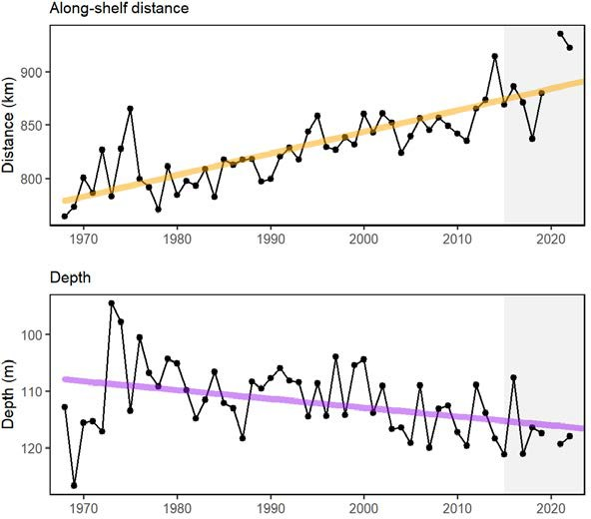
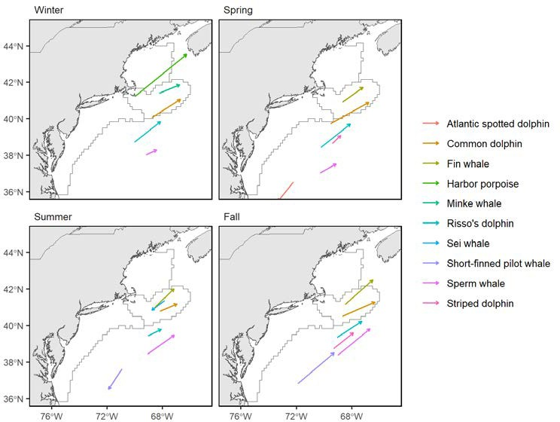
Risks to Managing Spatially: Coastwide
Indicators: Fish distribution shifts
Cetacean distribution shifts

Slide 31
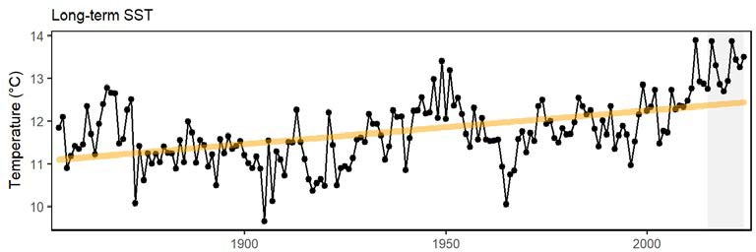
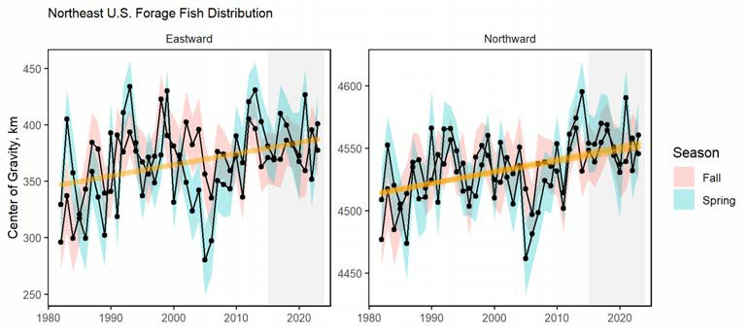



Risks to Managing Spatially: Coastwide
Drivers: changing ocean habitat
Drivers: Forage shifts, pelagic and benthic
Cold pool temperature and spatial extent

Slide 32




New Spatial Shift Indicators: BBeenntthhooss, ZZooooppllaannkkttoonn
Benthos center of gravity from fish stomachs
Copepods center of gravity from ECOMON

Slide 33

Risks to Managing Spatially: Coastwide
Future considerations
Distribution shifts caused by changes in thermal habitat and ocean circulation are likely to continue as long as long-term trends persist. Episodic and short-term events (see 2024 Highlights) may increase variability in the trends, however species distributions are unlikely to reverse to historical ranges in the short term. Increased mechanistic understanding of distribution drivers is needed to better understand future distribution shifts: species with high mobility or short lifespans react differently from immobile or long lived species.
Long-term oceanographic projections forecast a temporary pause in warming over the next decade due to internal variability in circulation and a southward shift of the Gulf Stream. Near-term forecasts are being evaluated to determine how well they are able to predict episodic and anomalous events that are outside of the long-term patterns.
Adapting management to changing stock distributions and dynamic ocean processes will require continued monitoring of populations in space and evaluating management measures against a range of possible future spatial distributions. Processes like the East Coast Climate Scenario Planning, and subsequent formation of the East Coast Climate Coordination Group, can help coordinate management.
How should forecasts be used within this report?

Slide 34


Risks to Managing Seasonally: Coastwide
Indicators: spawning timing, migration change
Recreational tuna fisheries 50 days earlier in the year in 2019 compared to 2002. In Cape Cod Bay, peak spring habitat use by right and humpback whales has shifted 18-19 days later over time.
Baseline information on large whale seasonal presence has been collected.

Slide 35


Risks to Managing Seasonally: New England
Future considerations
Management actions that rely on effective alignment of fisheries availability and biological processes should continue to evaluate whether prior assumptions on seasonal timings still hold.
New indicators should be developed to monitor timing shifts for stocks.
Drivers: thermal transition, habitat persistence, bloom timing
Bloom Timing

Slide 36


Risks to Setting Catch Limits: New England
Indicator: Fish productivity

Slide 37

Risks to Setting Catch Limits: New England
Indicator: Condition

Slide 38


Risks to Setting Catch Limits: New England Drivers
Drivers: Forage Quality and Abundance
New indicators: benthos abundance

Slide 39





Risks to Setting Catch Limits: New England Drivers
Drivers: Low trophic levels

Slide 40

Risks to Setting Catch Limits: Coastwide
Drivers: Environmental
2024 Thermal habitat area by depth

Slide 41

Risks to Setting Catch Limits: Coastwide
Drivers: Environmental Potential Ocean Acidification Impacts: Scallops and Longfin squid
Drivers: Predation
Seals increasing, mix of population status for HMS

Slide 42
Risks to Setting Catch Limits
Future considerations
Processes that control fish productivity and mortality are dynamic, complex, and are the result of the interactions between multiple changing system drivers.
There is a real risk that short-term predictions in assessments and rebuilding plans that assume unchanging underlying conditions will not be as effective, given the observed change documented in the prior sections in both ecological and environmental processes.
Assumptions for species’ growth, reproduction, and natural mortality should continue to be evaluated for individual species.
With observations of system-wide productivity shifts of multiple managed stocks, more research is needed to determine whether regime shifts or ecosystem reorganization are occurring, and how this should be incorporated into management.

Slide 43



Risks: Offshore Wind Development New England
Elements: OSW1 and OSW2
Indicators: fishery and community specific revenue in lease areas
Council request: New England ports relying on Mid- Atlantic managed species

Slide 44


Risks: Offshore Wind Development Summary
Implications:
Current plans for buildout of offshore wind in a patchwork of areas spreads the impacts differentially throughout the region
Planned wind areas overlap with one of the only known right whale foraging habitats, and altered local oceanography could affect right whale prey availability. Development also brings increased vessel strike risk and the potential impacts of pile driving noise.

Slide 45

2024 Highlights: Methods
Observations solicited from:
SOE contributors NEFSC colleagues Academic colleagues Management partners Fishing industry
We welcome your observations! northeast.ecosystem.highlights@noaa.gov
Observations included if:
Record high or low observations Different from recent conditions Reported by multiple sources Affecting fishery operations Newsworthy
Not exhaustive list; Full impacts remain to be seen
Reprinted from Cape Cod Commercial Fisherman's Alliance February 2025 Newsletter →

Slide 46


2024 Highlights: generally cooler, fresher Northeast Shelf
Globally, 2024 warmest year on record (above previous record 2023)
BUT, nearly all NE shelf seasonal surface and bottom temperatures back to longer term average
2023-2024 data suggest more Labrador slope water into the GOM (Record et al., 2024)
Linked to well-developed 2024 Mid Atlantic Cold Pool

Slide 47


2024 Highlights
Unusual timing, location, abundance:
Fishery observations
Delayed migration of longfin squid, black sea bass, haddock
Unusual locations for pollock, bluefin tuna, Atlantic mackerel, longfin squid, bluefish, and bonito
Local abundance of Atlantic mackerel Record catches of red drum in Chesapeake Bay
Good scallop recruitment in Nantucket lightship Arctic copepods in GOM
Cocolithophore bloom off NY Large whale aggregations
Extreme observation of ocean acidification risk off NJ
Multiple summer upwelling events off NJ

Slide 48

THANK YOU! SOEs made possible by (at least) 88 contributors from 20+ institutions
Andrew Applegate (NEFMC) Kimberly Bastille
Aaron Beaver (Anchor QEA) Andy Beet
Brandon Beltz
Ruth Boettcher (Virginia Department of Game and Inland Fisheries)
Mandy Bromilow (NOAA Chesapeake Bay Office)
Joseph Caracappa Samuel Chavez-Rosales
Baoshan Chen (Stony Brook University) Zhuomin Chen (UConn)
Doug Christel (GARFO) Patricia Clay
Lisa Colburn
Jennifer Cudney (NMFS Atlantic HMS Management Division)
Tobey Curtis (NMFS Atlantic HMS Management Division)
Art Degaetano (Cornell U) Geret DePiper
Bart DiFiore (GMRI)
Emily Farr (NMFS Office of Habitat Conservation)
Michael Fogarty Paula Fratantoni Kevin Friedland
Marjy Friedrichs (VIMS) Sarah Gaichas
Ben Galuardi (GAFRO)
Avijit Gangopadhyay (SMAST UMass Dartmouth)
James Gartland (VIMS)
Lori Garzio (Rutgers University) Glen Gawarkiewicz (WHOI) Laura Gruenburg
Sean Hardison Dvora Hart
Shannon Meseck Ryan Morse
Ray Mroch (SEFSC) Brandon Muffley (MAFMC) Robert Murphy
Kimberly Murray NEFSC staff
David Moe Nelson (NCCOS) Chris Orphanides
Richard Pace Debi Palka
Tarsila Seara Dave Secor (CBL) Emily Slesinger Angela Silva
Adrienne Silver (UMass/SMAST) Talya tenBrink (GARFO)
Abigail Tyrell Rebecca Van Hoeck
Bruce Vogt (NOAA Chesapeake Bay Office) Ron Vogel (University of Maryland Cooperative Institute for Satellite Earth System Studies and NOAA/NESDIS Center for Satellite Applications and Research) John Walden
Harvey Walsh Sarah Weisberg Changhua Weng Dave Wilcox (VIMS)
Timothy White (Environmental Studies Program BOEM)
Sarah Wilkin (NMFS Office of Protected Resources)
Mark Wuenschel
Qian Zhang (U Maryland)
Cliff Hutt (NMFS Atlantic HMS Management Tom Parham (Maryland DNR)
Division) Kimberly Hyde John Kocik
Steve Kress (National Audubon Society’s Seabird Restoration Program)
Young-Oh Kwon (Woods Hole Oceanographic Institution) Scott Large
Gabe Larouche (Cornell U) Daniel Linden
Andrew Lipsky Sean Lucey (RWE)
Don Lyons (National Audubon Society’s Seabird Restoration Program)
Chris Melrose Anna Mercer
CJ Pellerin (NOAA Chesapeake Bay Office) Charles Perretti
Kristin Precoda
Grace Roskar (NMFS Office of Habitat Conservation)
Jeffrey Runge (U Maine)
Grace Saba (Rutgers University) Vincent Saba
Sarah Salois
Chris Schillaci (GARFO) Amy Schueller (SEFSC) Teresa Schwemmer (URI)

Slide 49
References
DePiper, G. S. et al. (2017). "Operationalizing integrated ecosystem assessments within a multidisciplinary team: lessons learned from a worked example". En. In: ICES Journal of Marine Science 74.8, pp. 2076-2086. ISSN: 1054-3139. DOI: 10.1093/icesjms/fsx038. URL: https://academic.oup.com/icesjms/article/74/8/2076/3094701 (visited on Mar. 09, 2018).
Gaichas, S. K. et al. (2018). "Implementing Ecosystem Approaches to Fishery Management: Risk Assessment in the US Mid-Atlantic". In: Frontiers in Marine Science 5. ISSN: 2296-7745. DOI: 10.3389/fmars.2018.00442. URL: https://www.frontiersin.org/articles/10.3389/fmars.2018.00442/abstract (visited on Nov. 20, 2018).
Koul, V. et al. (2024). "A Predicted Pause in the Rapid Warming of the Northwest Atlantic Shelf in the Coming Decade". En. In: Geophysical Research Letters 51.17. _ eprint: https://onlinelibrary.wiley.com/doi/pdf/10.1029/2024GL110946, p. e2024GL110946. ISSN: 1944-8007. DOI: 10.1029/2024GL110946. URL: https://onlinelibrary.wiley.com/doi/abs/10.1029/2024GL110946 (visited on Feb. 11, 2025).
Record, N. R. et al. (2024). "Early Warning of a Cold Wave in the Gulf of Maine". In: Oceanography 37.3, pp. 6-9. DOI: 10.5670/oceanog.2024.506. URL: https://tos.org/oceanography/article/early-warning-of-a-cold-wave-in-the-gulf-of-maine (visited on Mar. 04, 2025).
Additional resources
ecodata R package
Indicator catalog
SOE Technical Documentation
SOE Reports on the web
Slides available at https://noaa-edab.github.io/presentations Contact: joseph.caracappa@noaa.gov

